Slide 1
DISCOVER YOUR FUTURE

Slide 2
ABOUT SUN
Notes:
What is SUN?
SUN is collaborative partnership of local universities, local authorities, colleges and schools across Hampshire, Dorset and the Isle of Wight
What does SUN do?
SUN offers a range of events and activities that aim to help young people decide on the best educational path for them
Why does SUN do this?
SUN is a part of Uni Connect whose goal is to ensure everyone who might benefit from higher education has access to it, whatever their background.
How can I get involved?
Workshops
Assemblies
Residentials
University visits

Slide 3
WHAT IS DISCOVER YOUR FUTURE?
1
This quiz based website aims to increase your knowledge and confidence when you are exploring Level 4 options
2
Explore local post-16 & 18 opportunities and discover the benefits and challenges of those choices
3
Compete with local schools for prizes!
4
Use Future Steps for hints, tips and to explore more

Slide 4
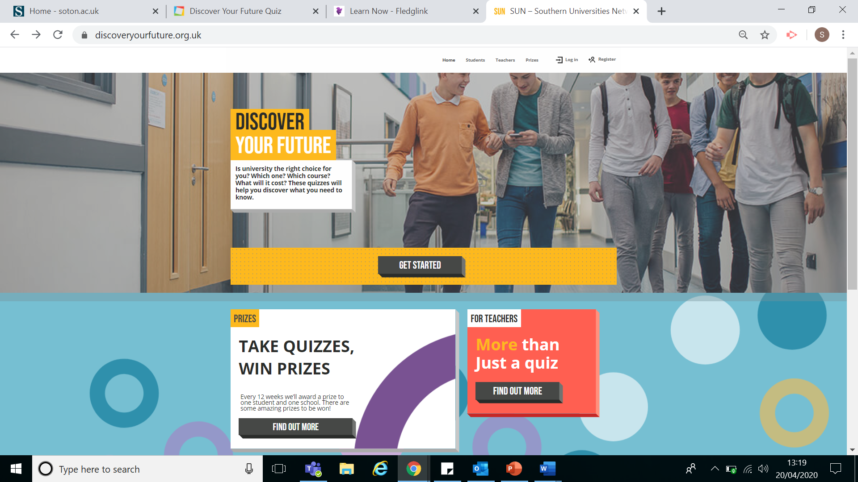
CREATING YOUR PROFILE

Slide 5
CREATING YOUR PROFILE
Click on ‘Register’

Slide 6
CREATING YOUR PROFILE
Complete the form
Click ‘register’

Slide 7
LOGGING IN TO YOUR PROFILE

Slide 8
LOGGING IN TO YOUR PROFILE
Click on ‘log in’

Slide 9
PATHWAYS
Once you have logged on, click on
get started to begin with the
Pathways quiz
Use the explore more button
to increase your knowledge as you
progress through the quiz
Think, what do you need to research
before making decisions
about your future?

Slide 10
PATHWAYS EXTENSION Well done! Now try the extra activities on the extension worksheet.
1
Research the qualifications you didn’t know about in the quiz and look at local providers that offer them
2
Research local degree apprenticeships on the government apprenticeship website
3
Chat to students, college & university staff on Future Steps to find out more! Chatfuturesteps.co.uk

Slide 11
FINANCES
Once you have logged on, click on
get started to complete the
Finances quiz
Use the explore more button
to increase your knowledge as you
progress through the quiz
Think, what do you need to research
before making decisions
about your future?

Slide 12
FINANCES EXTENSION Well done! Now try the extra activities on the extension worksheet.
1
Research what student finance is available to you and use it to fill in the grid
Incomings |  | Outgoings
DESCRIPTION | AMOUNT | DESCRIPTION | AMOUNT
Tuition fee Loan | £9,250 | Tuition fee | £9,250
Maintenance Loan | £8,944 | Rent – Halls of Residence University of Southampton | £5,404
Part time job | £135 x 44 weeks | Food per week | £30 (x 44 weeks) £1320
2
Chat to students, college & university staff on Future Steps to find out more! Chatfuturesteps.co.uk

Slide 13
UNIVERSITIES
Once you have logged on, click on
get started to complete the
Finances quiz
Use the explore more button
to increase your knowledge as you
progress through the quiz
Think, what do you need to research
before making decisions
about your future?

Slide 14
UNIVERSITIES EXTENSION Well done! Now try the extra activities on the extension worksheet!
1
Explore a range of universities across the UK
2
Chat to students, college & university staff on Future Steps to find out more! Chatfuturesteps.co.uk

Slide 15
PROGRAMMES
Once you have logged on, click on
get started to complete the
Finances quiz
Use the explore more button
to increase your knowledge as you
progress through the quiz
Think, what do you need to research
before making decisions
about your future?

Slide 16
PROGRAMMES EXTENSION Well done! Now try the extra activities on the extension worksheet!
1
Explore different degree choices and think about their pros and cons
 | Course | University’s offering course | Potential careers | Assessment type | Notes
e.g | Politics | University of Winchester, Bournemouth University, University of Southampton | Civil service, local government, MP | Exams and Coursework | Could combine with international relations or history
2
Chat to students, college & university staff on Future Steps to find out more! Chatfuturesteps.co.uk

